Slide 1


Business Insight’s Presentation
This presentation provides a comprehensive analysis of key business findings, strategic recommendations, and actionable insights to drive profitability and optimize retail operations. We delve into regional performance, product categories, customer segmentation, and channel efficiency to inform data-driven decision-making.

Slide 2

Chapter 1
Key Business Findings: Interpreting Performance Data
My analysis reveals critical insights into current retail performance, highlighting both strengths and areas requiring immediate attention. Understanding these trends is the first step toward effective strategic adjustments.
This section will cover:
Regional Profitability Imbalances
Product Quality Concerns
Valuable Customer Segments
Channel Profitability Differences
Customer Segmentation(RFMR)

Slide 3
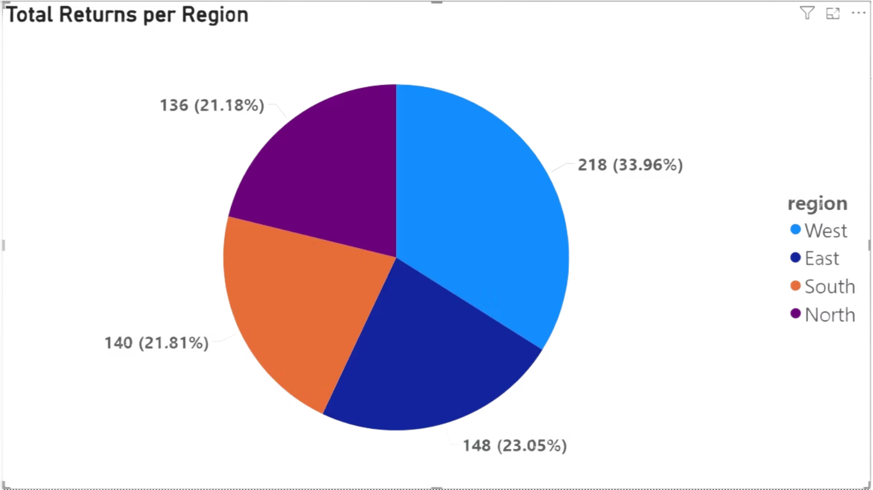


Regional Imbalance is Affecting Profitability
While the West and East regions are strong performers, the North region shows a significant and consistent decline in monthly profit over the last two years. This indicates a localized problem that needs immediate attention.

Slide 4
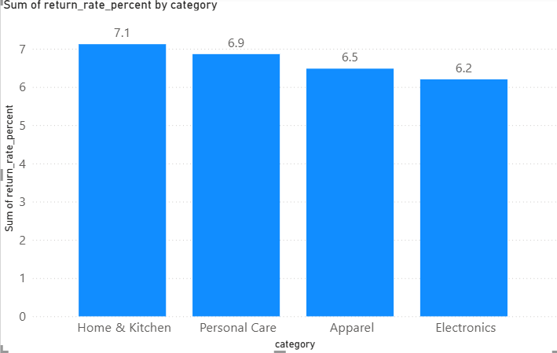

High Return Rate in Home & Kitchen is a Major Concern
The Home & Kitchen category has an ~7.1% return rate, far exceeding any other category. With "Defective" as the primary reason, this points to potential quality control issues that are damaging both profits and customer trust.

Slide 5
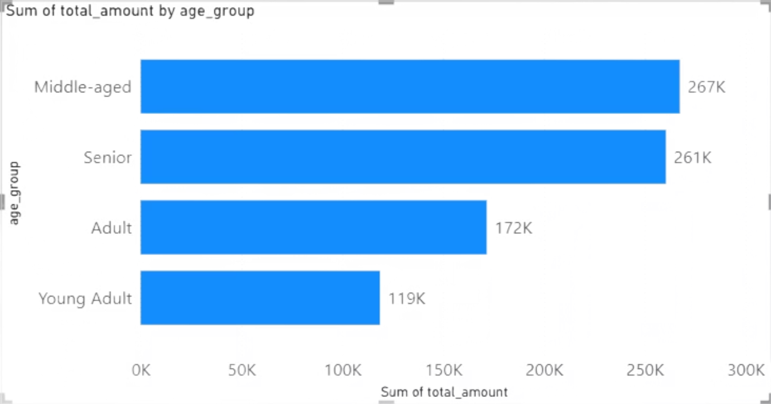

Loyal, Mature Customers are the Most Valuable
The Middle-aged group is the most profitable customer segment. Furthermore, the top 5 customers are long-term patrons (average tenure > 2.4 years), highlighting the importance of customer loyalty.

Slide 6
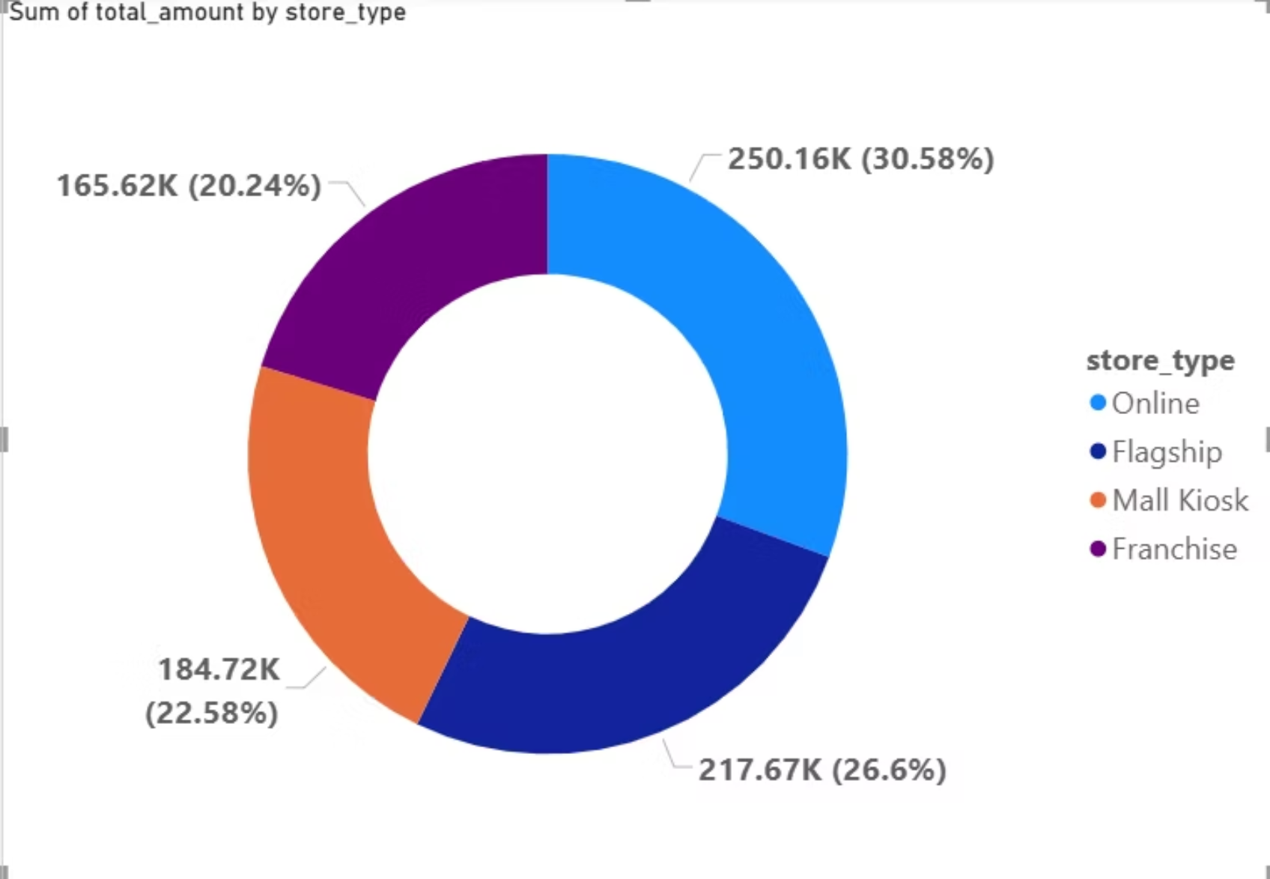

Online Channel Shows Higher Profit Efficiency
"On a per-transaction basis, the Online channel is more profitable than the In-Store channel, likely due to lower overhead costs."
The data clearly indicates that for every transaction, online sales yield a higher profit margin. This efficiency can be attributed to reduced operational overheads such as lower staffing requirements and decreased physical store maintenance costs. Capitalizing on this insight is crucial for optimizing overall profitability.

Slide 7
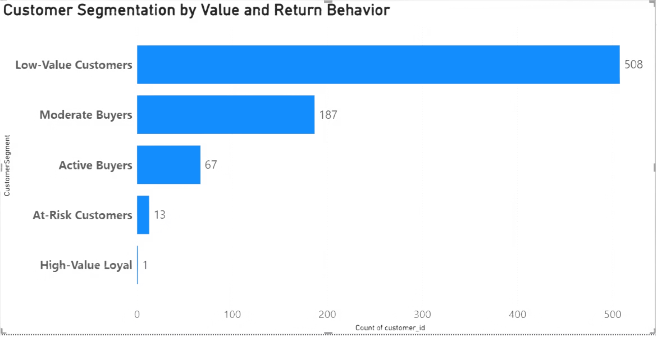



Customer Segmentation using RFMR in Power BI
I used RFMR (Recency, Frequency, Monetary, Returns) metrics to segment customers.This segmentation helps in prioritizing promotions, running targeted campaigns, and improving profitability instead of treating all customers equally.
Customer Segments Identified:
High-Value Loyal → Loyal & high-value customers, best group for retention and rewards.
High-Value but High Returns → Spend a lot but return often, need monitoring and stricter policies.
Active Buyers → Mid-spenders with low returns, good growth potential.
Active but High Returns → Purchase actively but returns are costly; targeted interventions needed.
At-Risk Customers → Previously active but declining; require win-back campaigns.
Moderate Buyers → Average customers, steady contributors.
Low-Value Customers → Low spend and activity, minimal focus needed.
RFM Ranges from Data:
Recency: 142 → 864 days
Frequency: 1 → 24 purchases
Monetary: $30 → $9675

Slide 8

Chapter 2
Strategic Recommendations: Driving Future Performance
Based on My key findings, I propose a set of strategic recommendations designed to address challenges and capitalize on opportunities. These actions aim to enhance profitability, improve customer satisfaction, and strengthen our market position.
This section will outline strategies for:
Quality Control Overhaul
Customer Loyalty & Acquisition
Online Channel Optimization

Slide 9

Quality Control Overhaul ⚙️
With "Defective" and "Wrong Item" being the primary drivers of returns, a full quality control overhaul is essential. We will implement a root-cause analysis program and introduce stricter quality checks at both the supplier and fulfillment stages. This will significantly reduce return-related costs and improve overall customer satisfaction and trust.
Customer Loyalty & Acquisition 👥
Our strategy will focus on two fronts: retaining our high-value Middle-aged and Senior customers through a new loyalty program, and actively acquiring the under-tapped Young Adult segment. This dual approach ensures we protect our core revenue stream while building a foundation for future growth.
Online Channel Optimization 🚀
The online channel is our largest untapped growth opportunity. We will execute a dedicated optimization strategy, including investing in digital marketing, enhancing the e-commerce user experience, and creating online-exclusive offers. The goal is to transform our online presence into a major revenue driver, rivaling our in-store success.

Slide 10

Chapter 3
Business Goal Attainment: How Analytics Answer Key Questions
My end-to-end retail analytics directly address critical business objectives, providing clear, data-driven answers to enhance decision-making and operational efficiency.
01
02
03
Sales Trends & Anomalies
Customer Behavior & Segmentation
Product Performance & Inventory
Identified overall revenue ( last 12 months), declining East region Revenue, and flagged anomalous high-quantity orders.
Segmented customers by region and age, highlighting the 35-50 age group as most valuable and identifying top 5 loyal, long-tenured customers.
Identified top 5 best-selling products and the Electronics category return rate is high due to defects, crucial for inventory and quality control.
04
05
Store & Regional Profitability
Data-Driven Decision Support
Pinpointed the most profitable store (S017), the declining East region, and the higher profit per transaction in the Online channel.
Analysis answers 10 key business questions using SQL, forming the foundation for BI dashboards and reports to guide strategic investments and cost reductions.
Notes:
This chapter covers how my end-to-end retail analytics directly address critical business objectives, providing clear, data-driven answers to enhance decision-making and operational efficiency. I'll start by highlighting the key insights from my analysis of sales trends and anomalies, including overall revenue, declining profitability in the South region, and flagged high-quantity orders that require further investigation. Next, I'll share my findings on customer behavior and segmentation, including how I identified the most valuable 41-60 age group and the top 5 loyal, long-tenured customers. Turning to product performance and inventory, I'll discuss the top 5 best-selling products and the high return rate in the Electronics category, which is crucial for inventory and quality control. I'll then dive into the analysis of store and regional profitability, pinpointing the most profitable store, the declining South region, and the higher profit per transaction in the Online channel. Finally, I'll summarize how this comprehensive analysis answers 10 key business questions, forming the foundation for BI dashboards and reports to guide strategic investments and cost reductions.

Slide 11

Thank you

